Slide 1

Learn Together
You’ll never study alone again

Slide 2








Slide 3
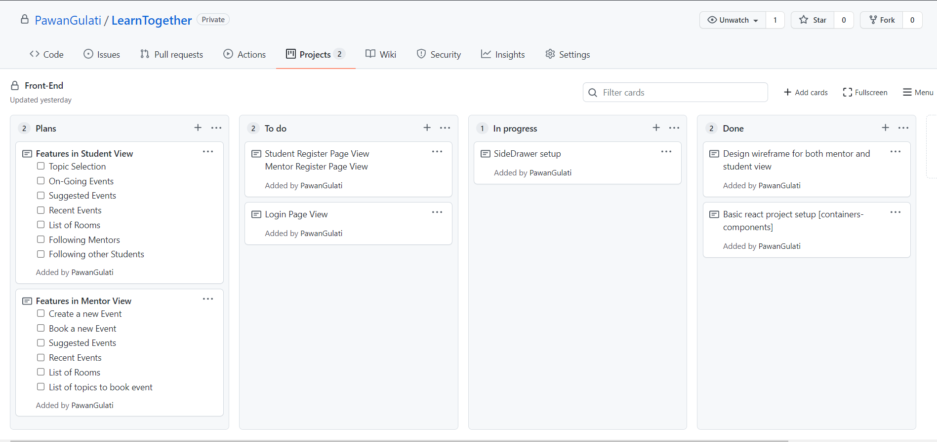
AGILE METHODOLOGY

Slide 4
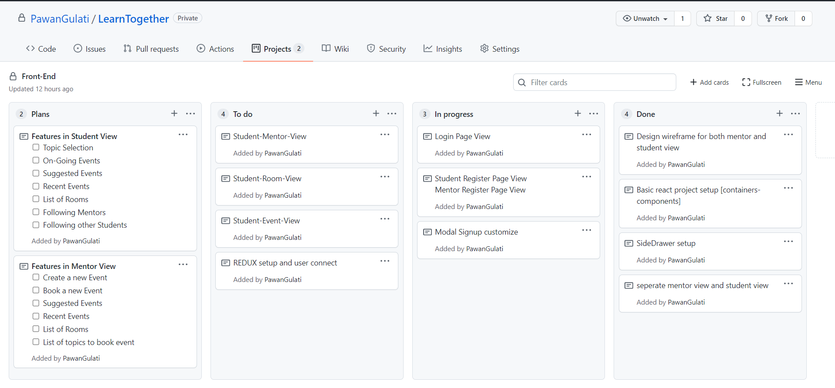

Slide 5
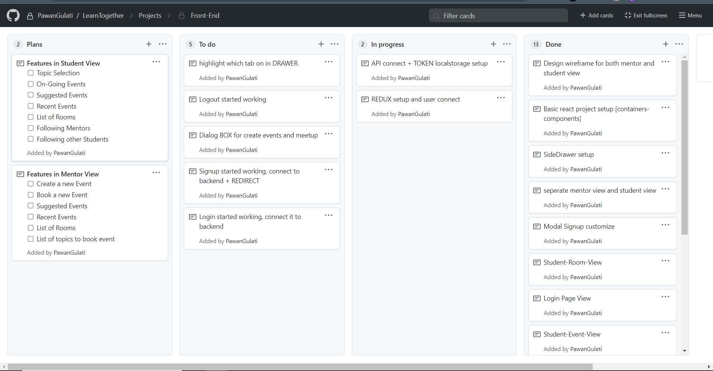

Slide 6
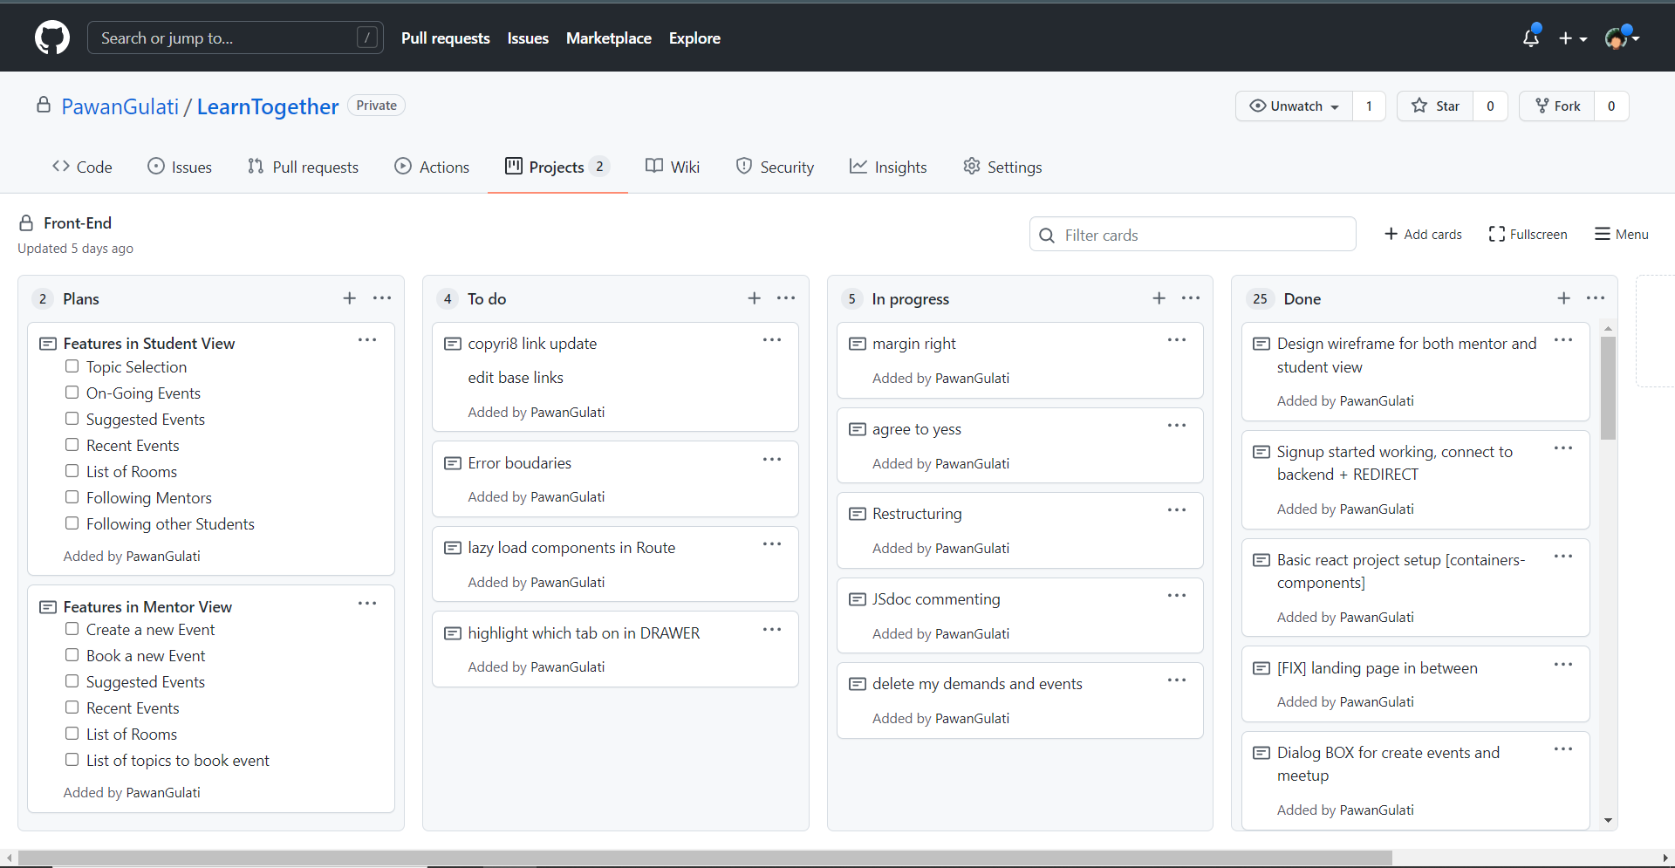

Slide 7
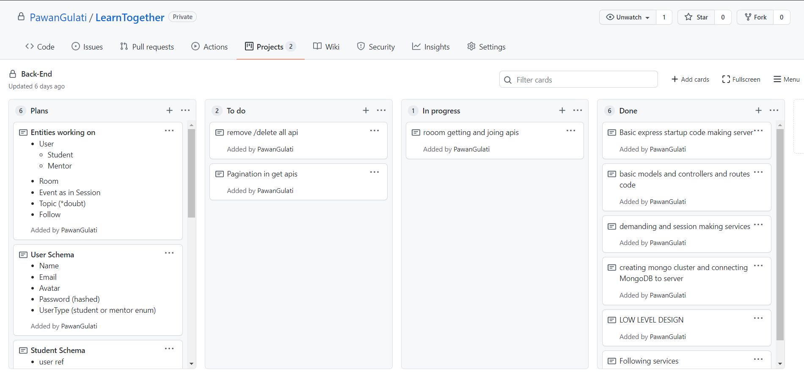

Slide 8
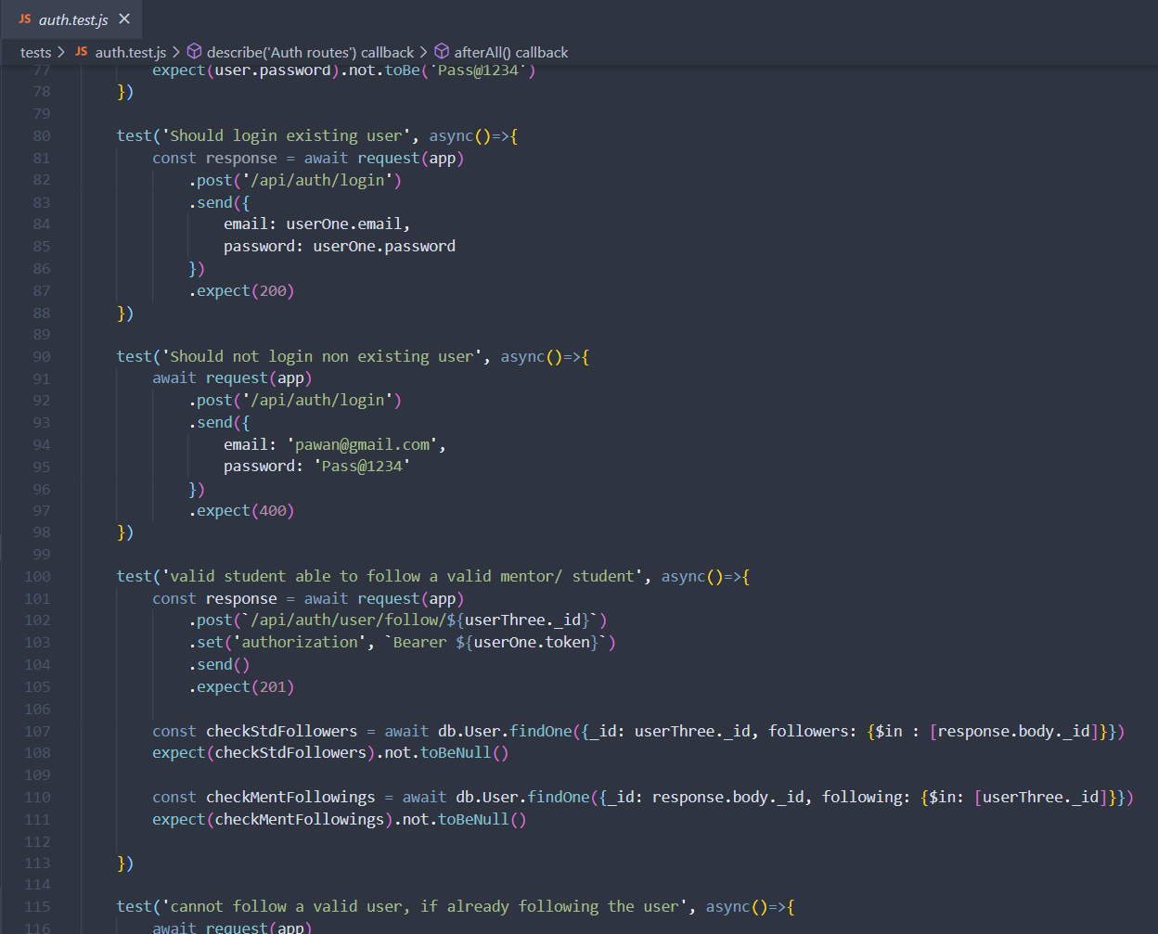
JEST UNIT TESTING

Slide 9
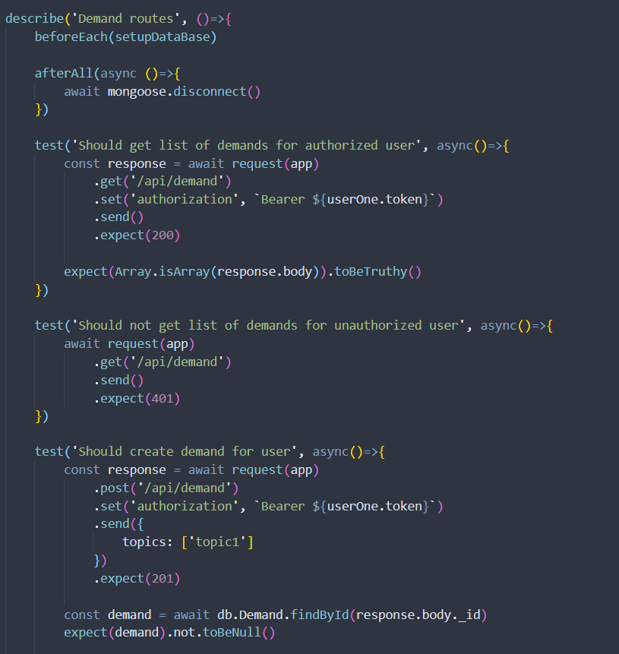

Slide 10
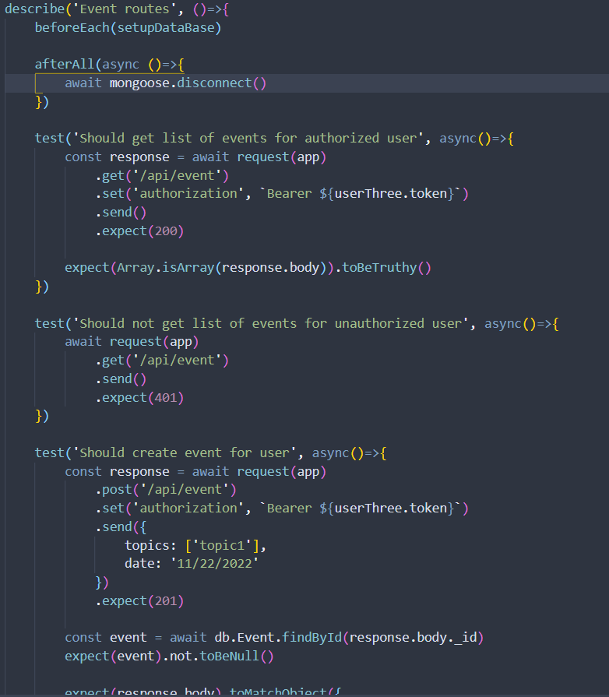

Slide 11
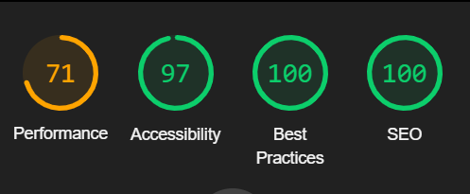

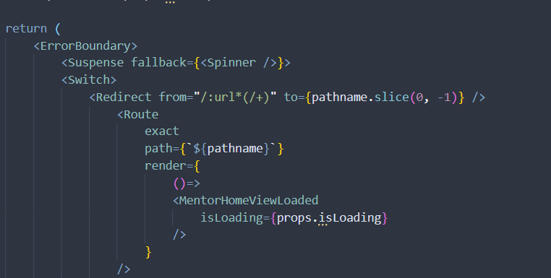
React.lazy()
Suspense()
<Errorboundaries />

Slide 12


STUDENT
REQUESTING
SERVICES
APP
BOOKING
FOLLOWING
MENTOR

Slide 13

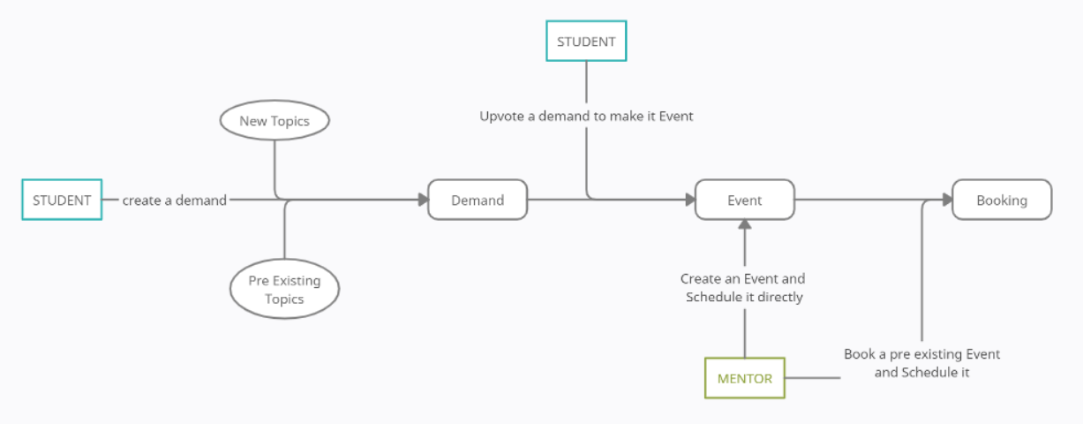


Slide 14
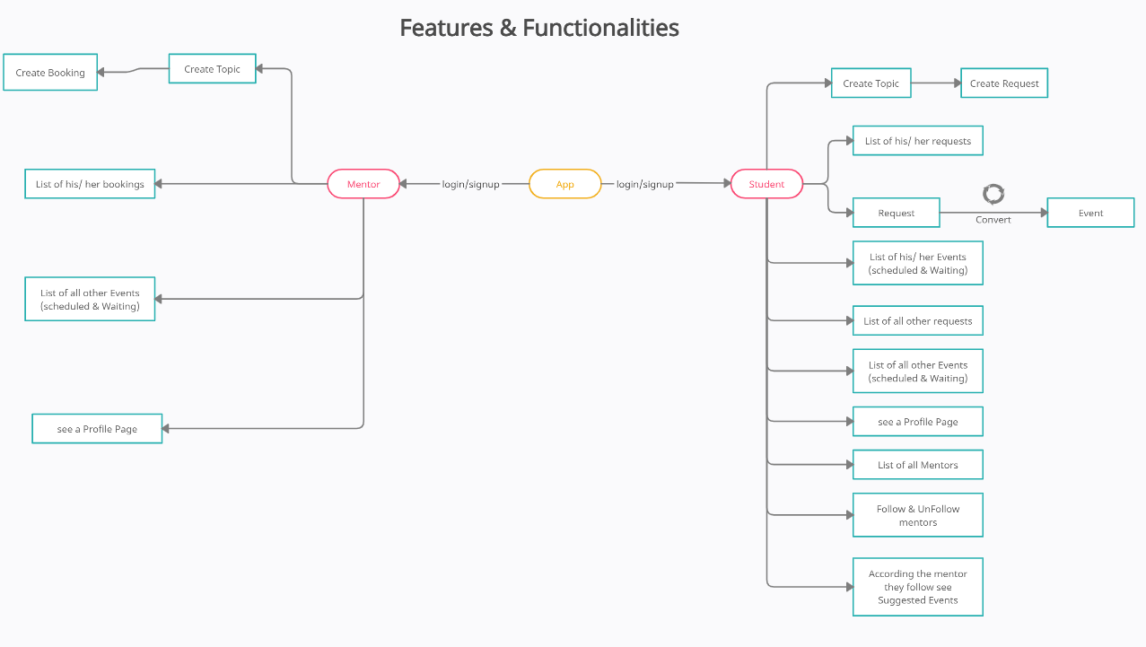

Slide 15
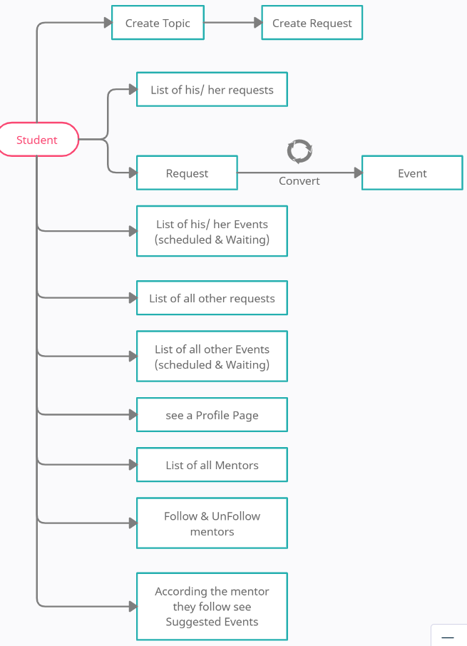

STUDENT

Slide 16
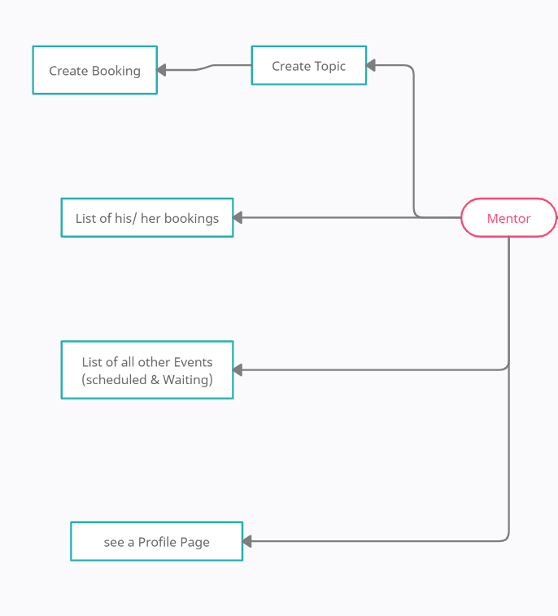

MENTOR

